Slide 1
Statistical Estimation - Maximum Likelihood Estimator (MLE)

Slide 2
PROBABILITY DISTRIBUTION
A probability distribution is a mathematical function or rule that describes how the probabilities of different outcomes are assigned to the possible values of a random variable.
It provides a way of modeling the likelihood of each outcome in a random experiment.
Described by PMF and PDF.
Types: Discrete Probability Distributions
Continuous Probability Distributions

Slide 3
Discrete Probability Distributions
Bernoulli distribution
Binomial Distribution
Poisson distribution

Slide 4
Bernoulli Trial
An experiment or process that has exactly two possible outcomes, usually labelled
  Success (1 ) — happens with probability p
  Failure (0) - happens with probability 1- p
Key Features of a Bernoulli Trial:
  Two outcomes only : success/failure, yes/no, head/tail, defective/good, etc.
  Fixed probability of success (p): does not change from trial to trial.
  Independence: Outcome of one trial does not affect the outcome of another.

Slide 5
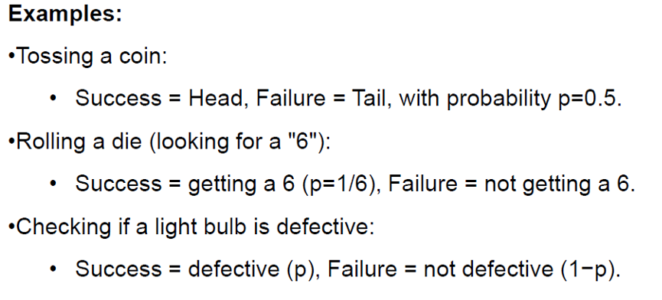
Bernoulli Trial

Slide 6
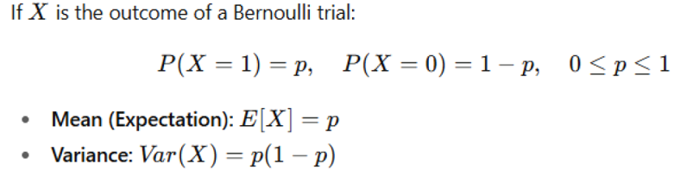
Bernoulli distribution

Slide 7
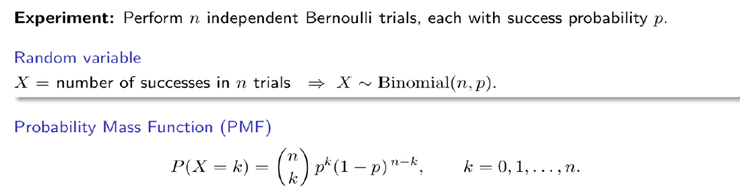
Binomial Distribution

Slide 8
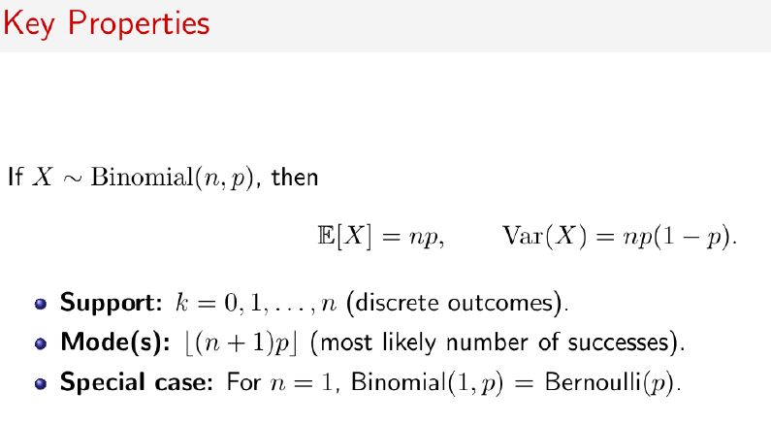
Binomial Distribution

Slide 9
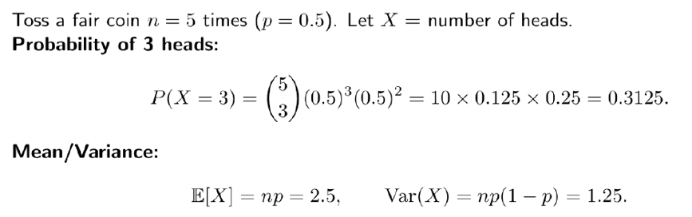
Example

Slide 10

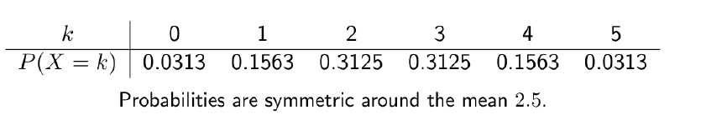
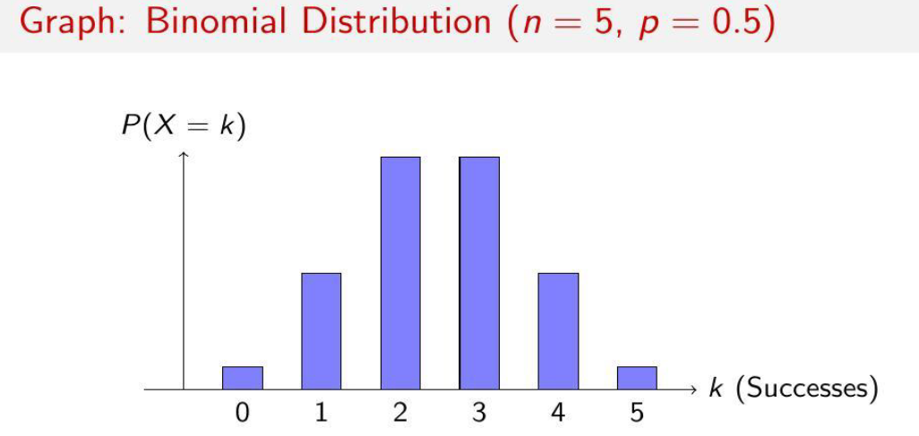
Example

Slide 11
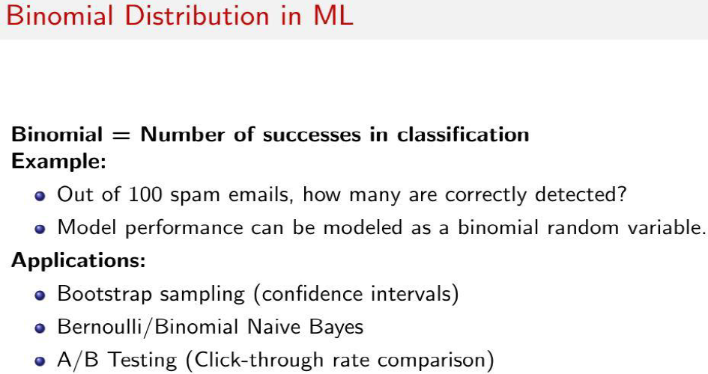

Slide 12
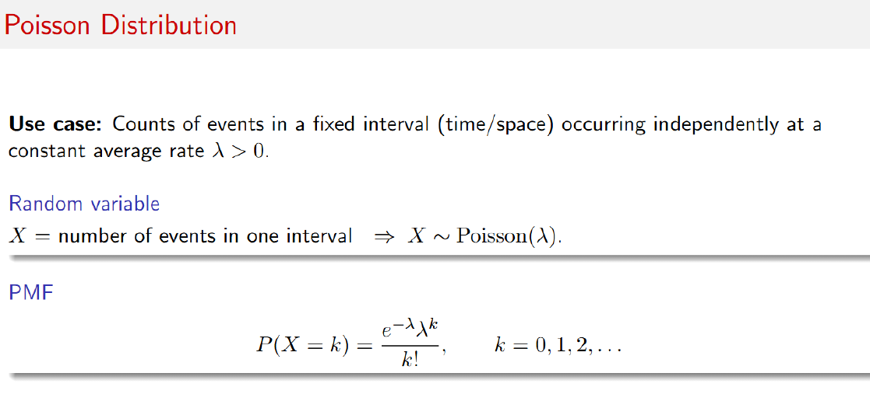

Slide 13
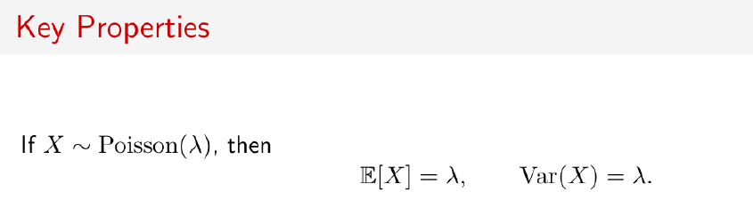
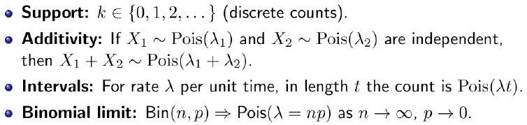
POISSON DISTRIBUTION

Slide 14
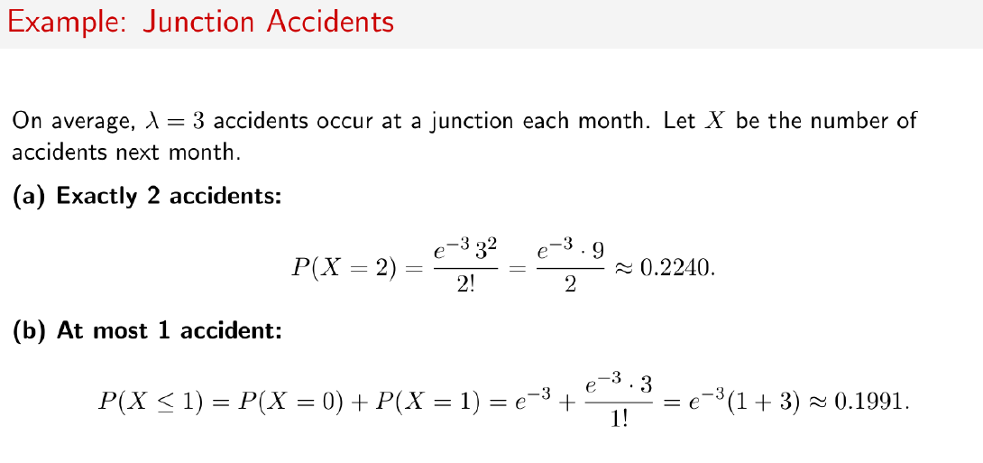

Slide 15
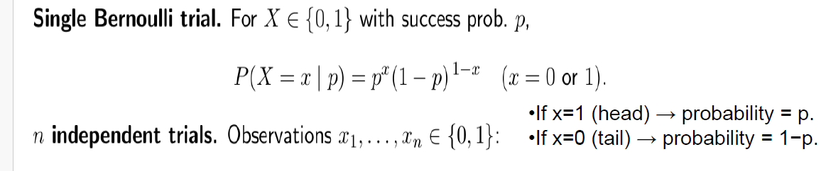
BERNOULLI DISTRIBUTION

Slide 16
Continuous Probability Distributions
Uniform distribution
Normal distribution
Exponential distribution

Slide 17
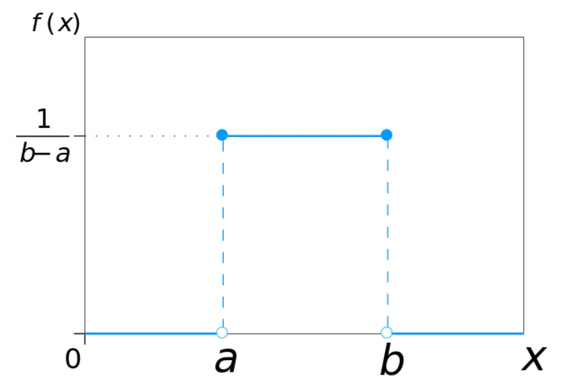

Uniform distribution
Uniform Distribution models equally likely outcomes over a closed interval [a,b], where the probability is uniform.

Slide 18
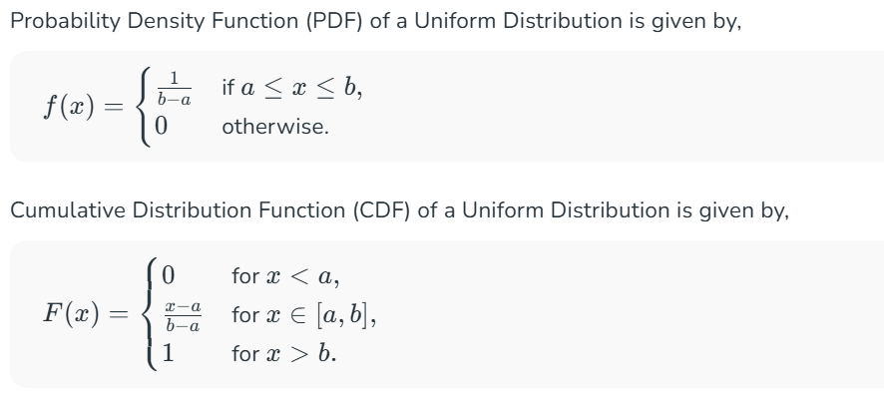
Uniform distribution

Slide 19
Uniform distribution: Example
Consider the time it takes for a traffic signal to turn green after it has been red. Assume that the time the signal takes to turn green is uniformly distributed between 20 seconds and 40 seconds.
The minimum value (a) = 20 seconds. The maximum value (b) = 40 seconds.
The continuous uniform distribution function:
f(x) = 1 / (40–20) = 1 / 20 for 20 ≤ x ≤ 40
f(x) = 0 otherwise
At any time between 20 seconds and 40 seconds, the probability of the signal turning green has an equal probability of 1/20.
The probability of the signal turning green in exactly 25 seconds = 1/20.
Similarly, the probability of the signal turning green in exactly 30 seconds = 1/20.

Slide 20
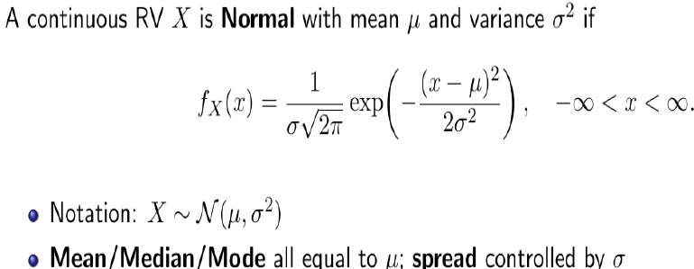
Normal distribution or Gaussian distribution
The parameter ⁠μ is the mean or expectation of the distribution, while the parameter σ² is the variance. The standard deviation of the distribution is ⁠σ(sigma).

Slide 21
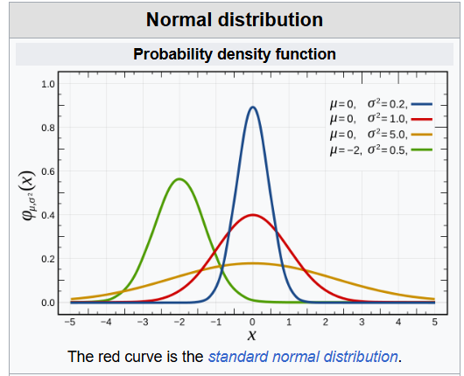
Normal distribution or Gaussian distribution
A random variable with a Gaussian distribution is said to be normally distributed, and is called a normal deviate.

Slide 22
Normal Distribution Examples
We can draw a Normal Distribution for various types of data that include,
Distribution of Height of People.
Distribution of Errors in any Measurement.
Distribution of Blood Pressure of any Patient, etc.

Slide 23
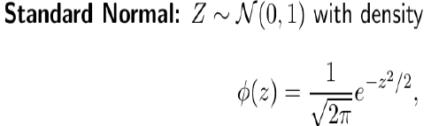
Standard normal distribution
Normal distributions with a mean ⁠μ and standard deviation can be transformed into the standard normal distribution with mean of zero and standard deviation of one.

Slide 24
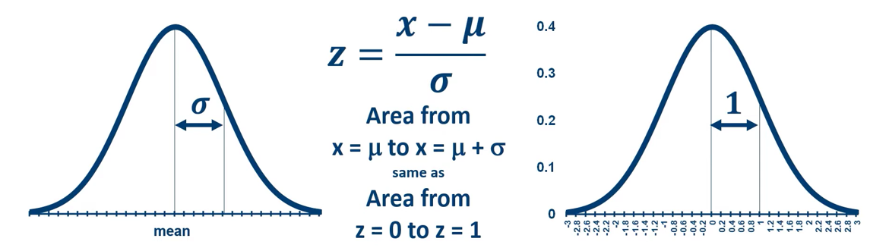
Standard normal distribution
Regions within the original normal distribution correspond to regions in the standard normal distribution.
Areas in the standard normal distribution are known and tabulated in tables (or stored in statistics programs).

Slide 25
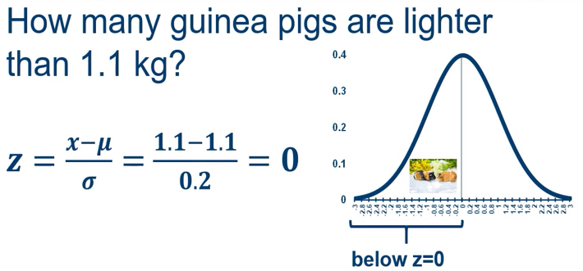
Example 1
Consider a population of 80 guinea pigs in which the mean mass is 1.1 kg and the standard deviation is 200g (0.2 kg).

Slide 26
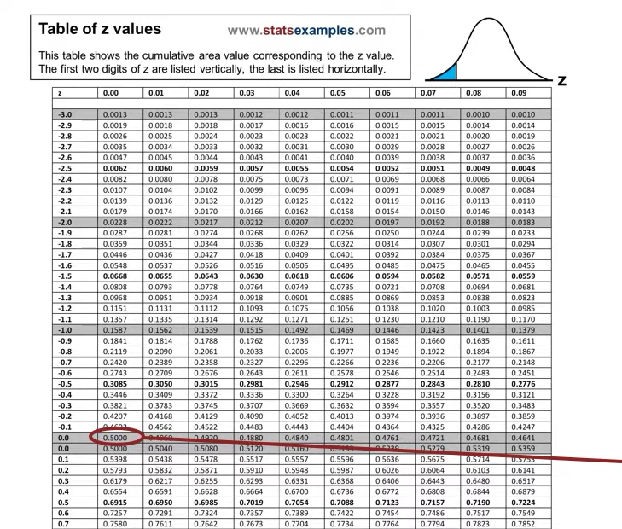

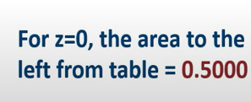
Example 1-answ

Slide 27
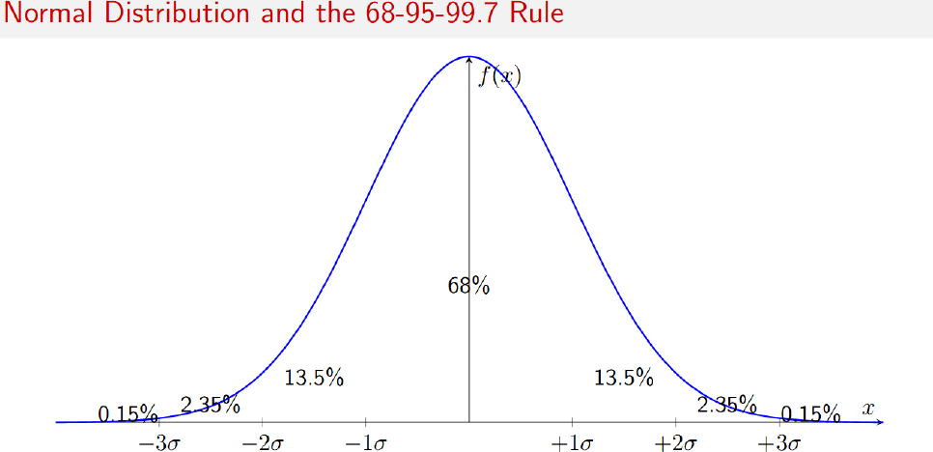

Slide 28
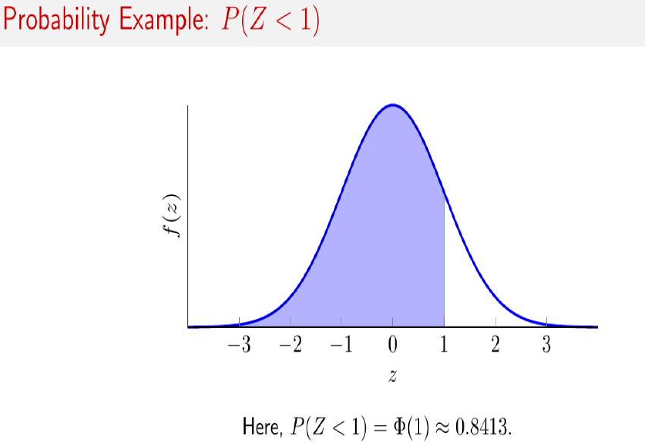

Slide 29
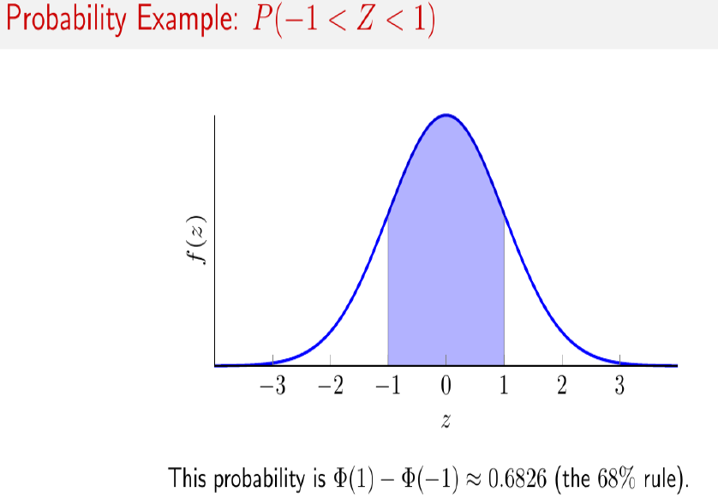

Slide 30
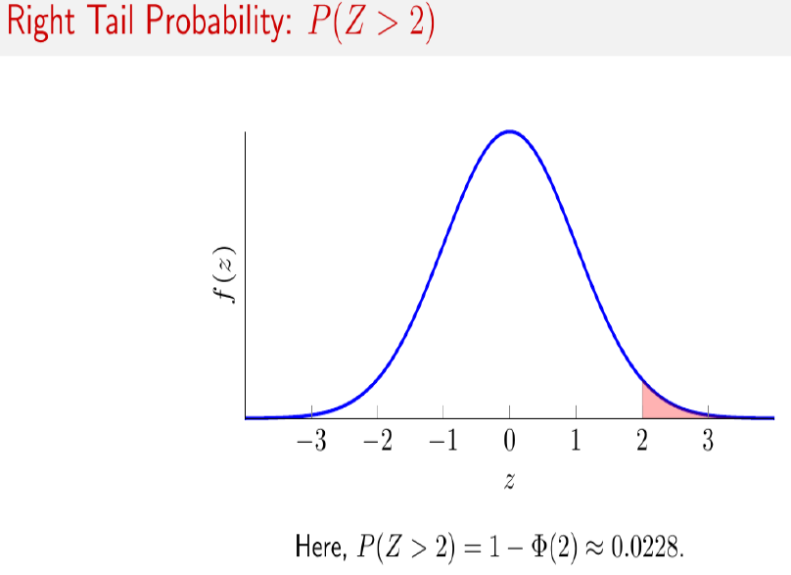

Slide 31
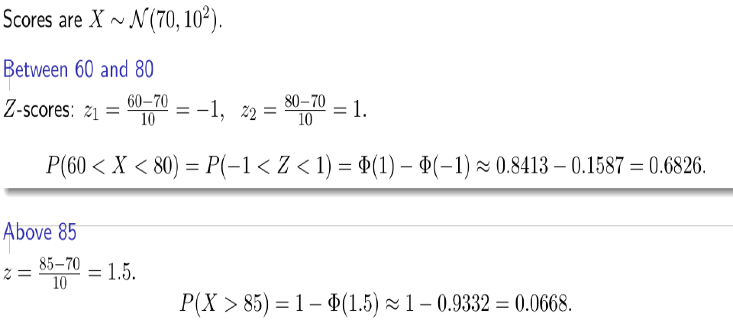

Slide 32
Exponential distribution
The Exponential Distribution is one of the most commonly used probability distributions in statistics and data science.
It is widely used to model the time or space between events in a Poisson process.
In simple terms, it describes how long you have to wait before something happens, like a bus arriving or a customer calling a help center.
For example, if buses arrive at a bus stop every 15 minutes on average, the time you wait for the next bus can be modelled using an exponential distribution.

Slide 33
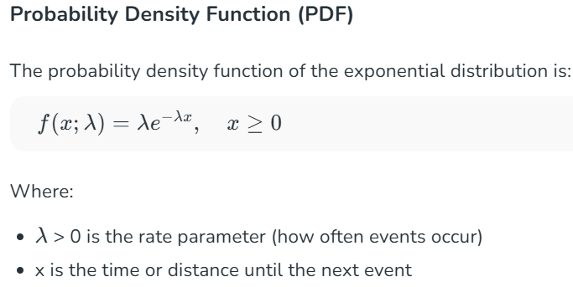
Exponential distribution

Slide 34
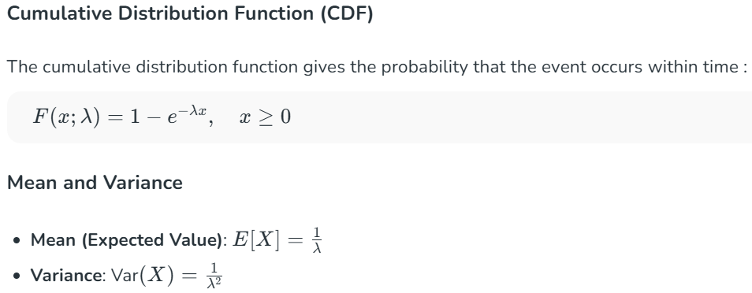
Exponential distribution

Slide 36
Statistical estimation
Statistical estimation is the process of using a sample of data to make an "educated guess" about a characteristic (a parameter) of a much larger group, known as a population.
It involves applying statistical rules called estimators to observed data to calculate
  Point estimates (a single value, like the sample mean for the population mean) or
  Interval estimates (a range of values, like a confidence interval for the population mean).

Slide 37
Key terms
Population: The entire group of interest (e.g., all students in a school, all steel produced).
Parameter: A numerical characteristic of a population (e.g., the true mean height of all people).
Sample: A subset of the population from which data is collected.
Statistic: A numerical characteristic of a sample (e.g., the mean height of a sample of students).
Estimator: A rule or formula used to calculate an estimate from sample data (e.g., the sample mean is an estimator for the population mean).
Estimate: The single computed value produced by an estimator.

Slide 38
Example: Estimating a Population Parameter
Goal: average height of all students in a college (unknown parameter).
Action: measure the height of all students in a class and compute the average (statistic).
Use the class average as an estimate of all student’s true average.

Slide 39
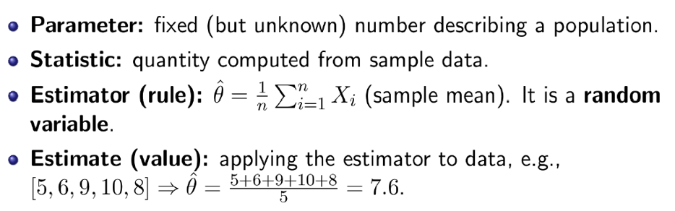
Parameter vs. Statistic & Estimator vs. Estimate

Slide 40
Why Estimation Matters in Al and Data Science
Models in ML Al have unknown parameters (e.g., mean/variance of a Gaussian).
We need estimators to: train models, predict outcomes, and quantify uncertainty.
This motivates systematic methods like Maximum Likelihood Estimation (MLE)

Slide 41
LIKELIHOOD ESTIMATE
Likelihood estimation is a statistical method to estimate the parameters of a statistical model by finding the parameters that maximize the likelihood function, which is the probability of observing the given data under the assumed model.
This technique, known as Maximum Likelihood Estimation (MLE), finds the parameter values (maximum likelihood estimates) that make the observed data most probable, providing the best "fit" for the data within the assumed model.

Slide 42
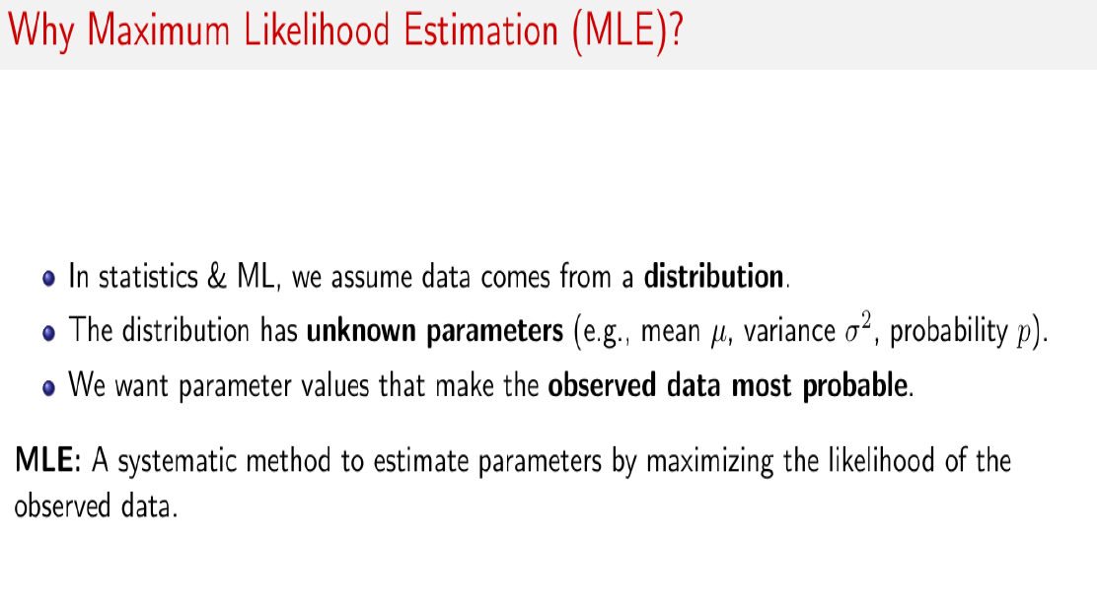

Slide 43
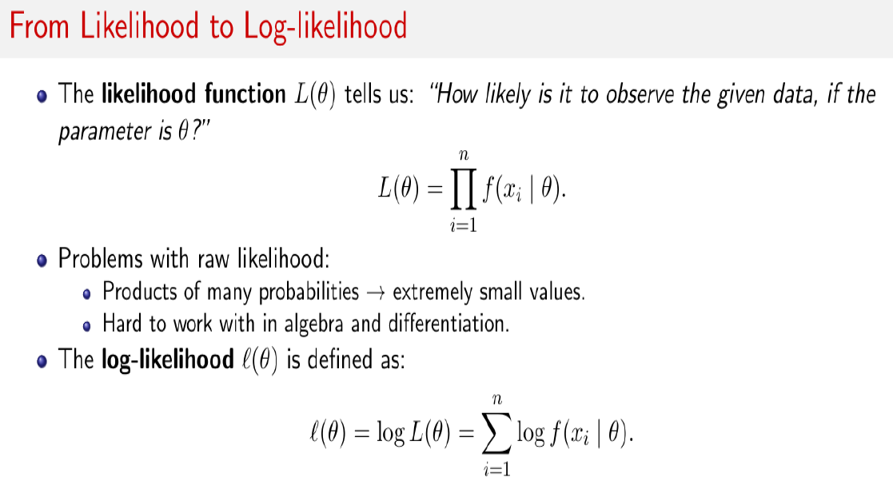

Slide 44
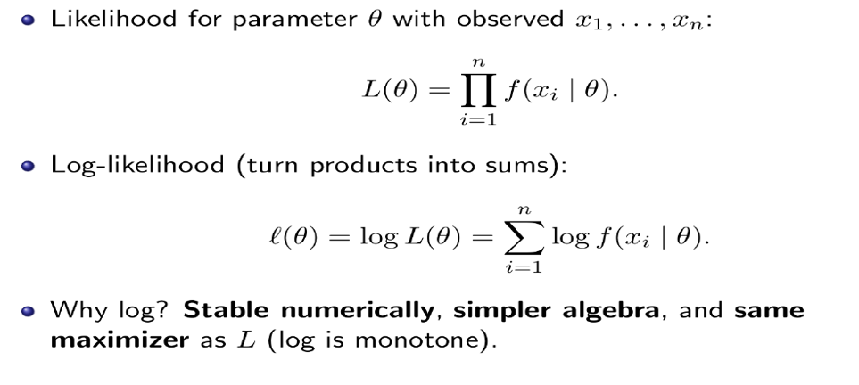
Log-likelihood function

Slide 45
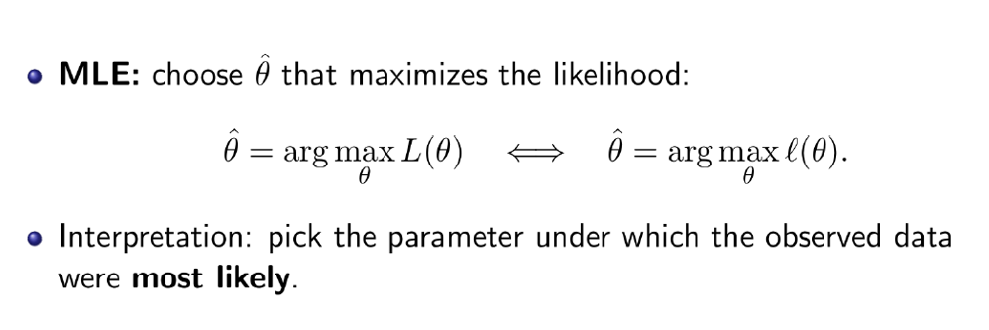

Slide 46
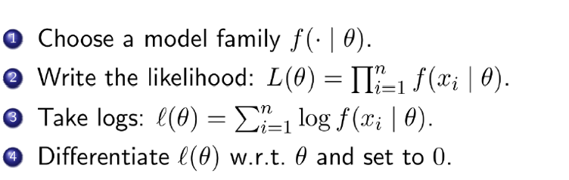
Steps for calculating Maximum Likelihood Estimate(MLE)

Slide 47
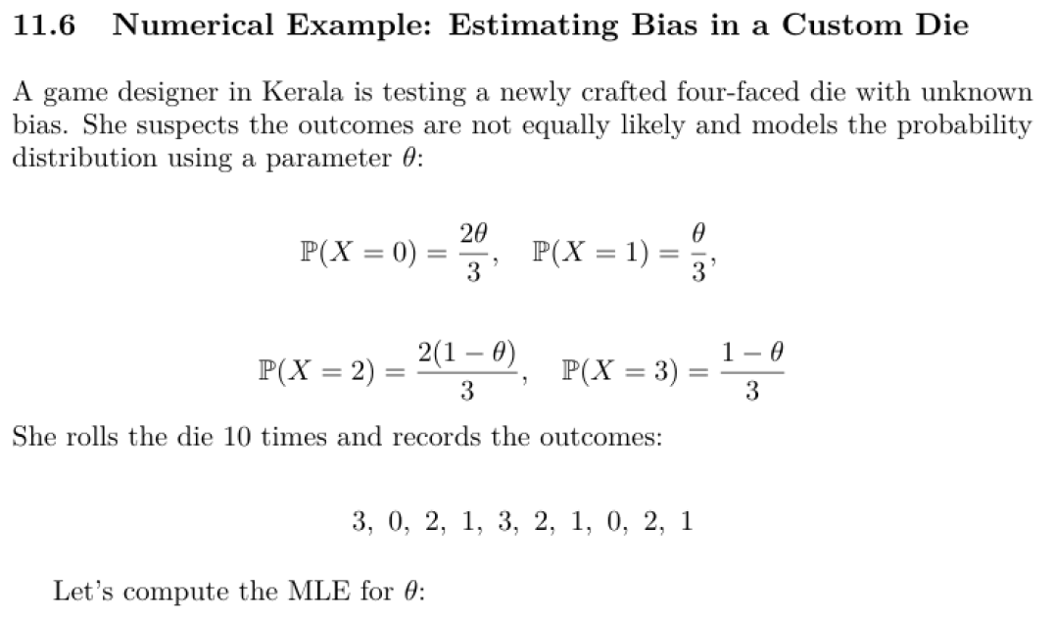

Slide 48
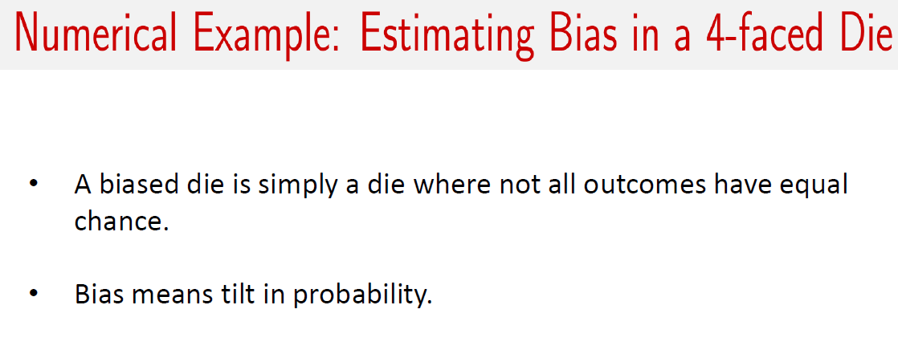

Slide 49
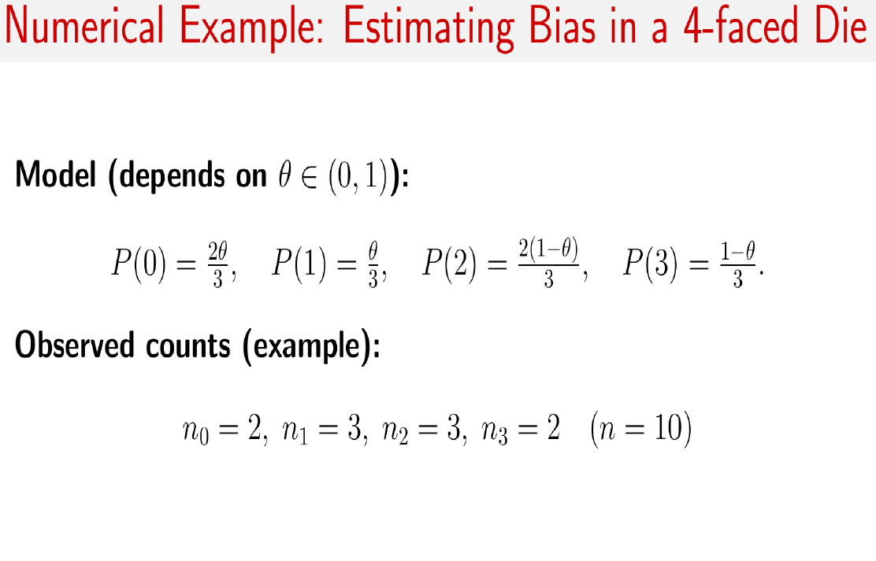

Slide 50
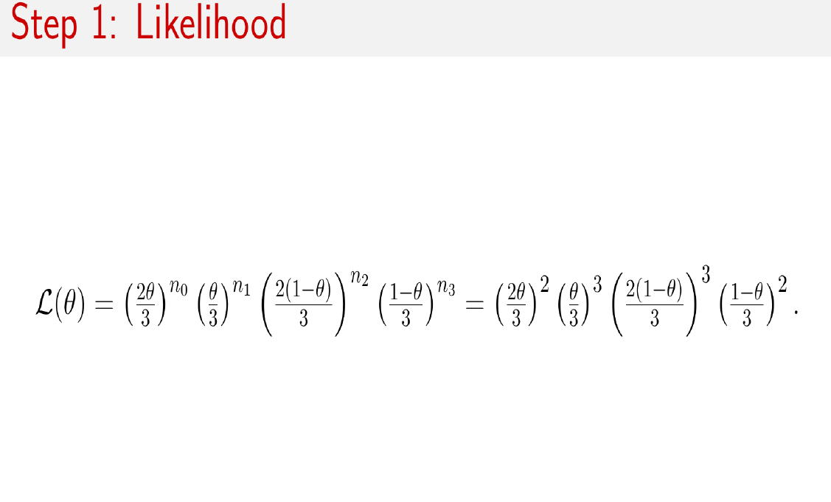

Slide 51
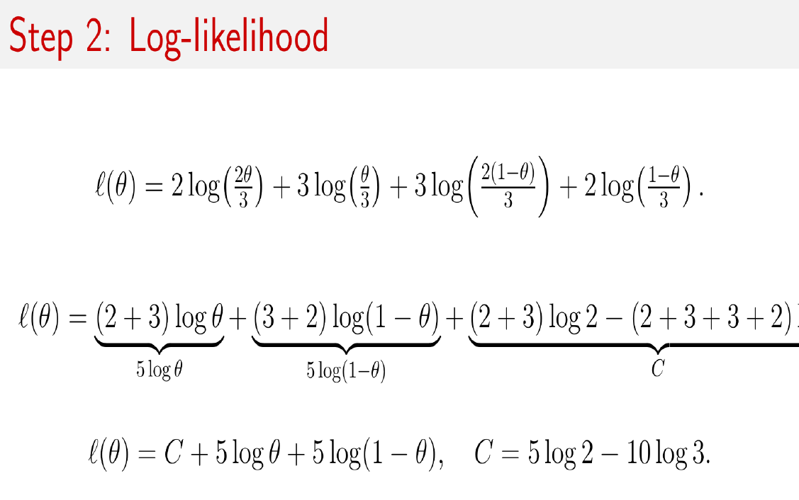

Slide 52
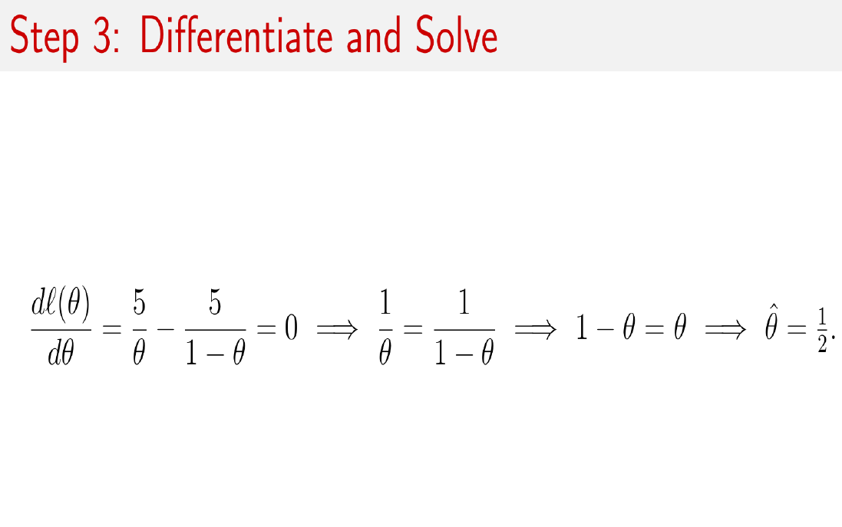

Slide 53
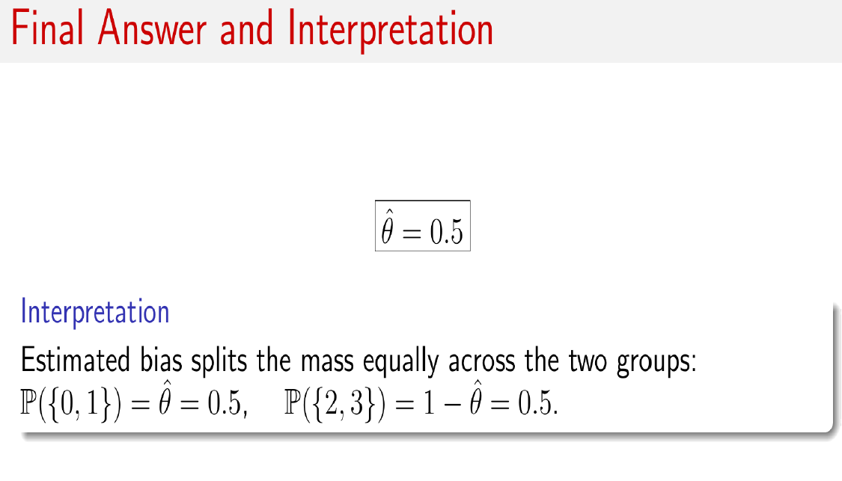
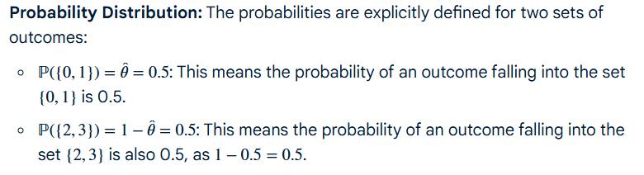

Slide 54
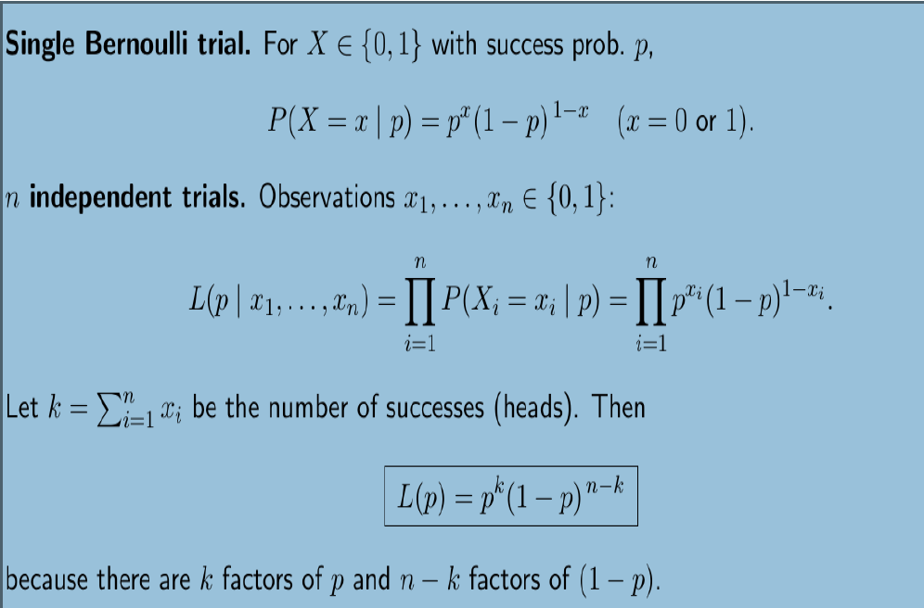
MLE for Bernoulli distribution

Slide 55
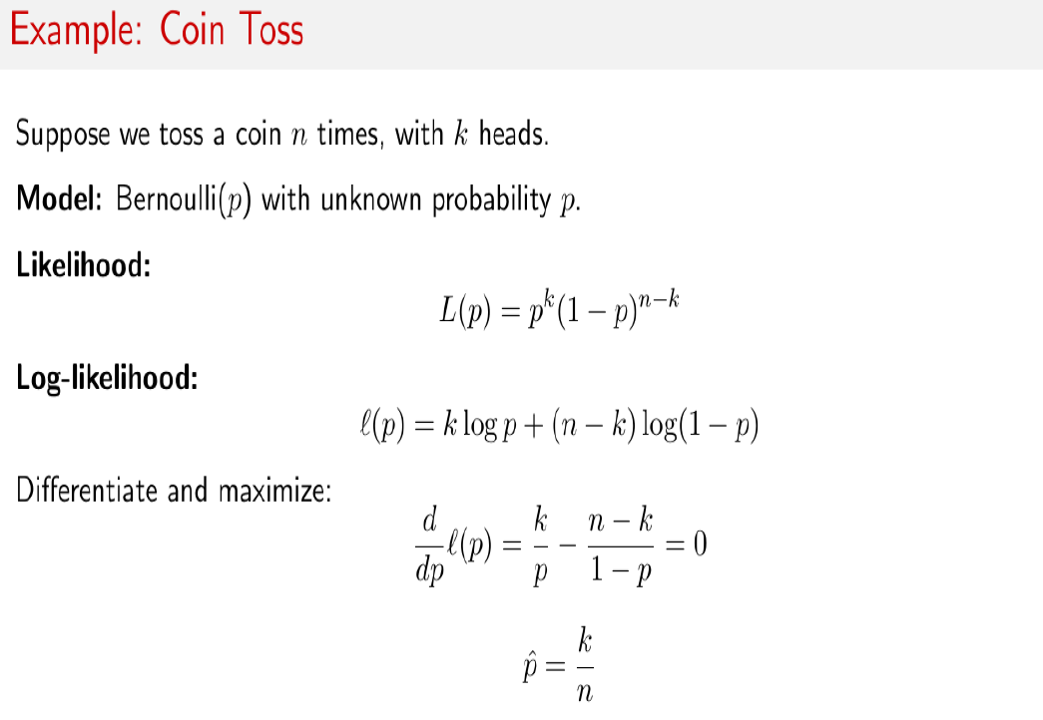

Slide 56
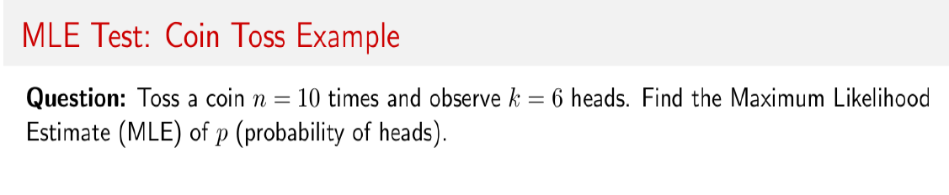
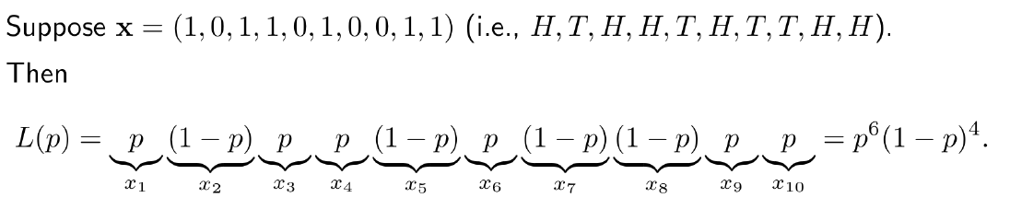
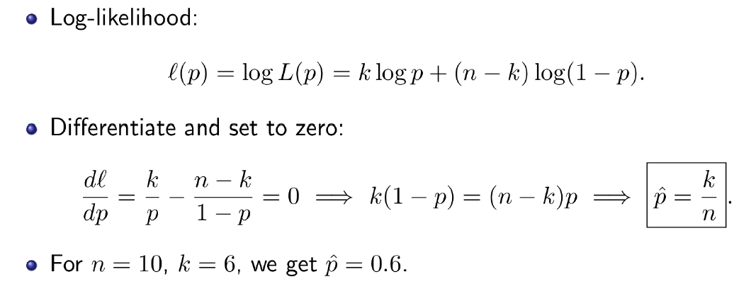

Slide 57
Common Estimation Methods
Method of Moments: This technique equates moments (like the mean or variance) calculated from the sample to the corresponding moments of the population, solving the resulting equations to estimate parameters.
Maximum Likelihood Estimation (MLE): MLE finds the parameter values that maximize the probability of observing the given sample data.
Least Squares Estimation: This method finds the parameters that minimize the sum of the squared differences between observed values and those predicted by the model.
Bayesian Estimation: This approach uses a Bayesian perspective to update prior beliefs about parameters in light of observed data, providing an estimate that incorporates both prior information and the likelihood of the data.

Slide 58
Assignment 3 –issued on 30-09-25
Suppose we have a set of data points that we believe are drawn from a normal distribution with unknown mean μ and variance sigma². Our goal is to estimate the parameters μ and sigma² using MLE. find the MLE estimates for the parameters of the normal distribution.
Submission by 7/10/25.
2. Differentiate Point estimation vs. interval estimation with examples.

Slide 59
Least Squares Estimation
Least Squares Estimation: This method finds the parameters that minimize the sum of the squared differences between observed values and those predicted by the model.
Least squares estimation is a fundamental method in linear regression for finding the "line of best fit" by minimizing the sum of the squared differences (residuals) between the observed data and the model's predictions.
It is an optimization technique that provides the coefficients for a linear equation that best describe the relationship between variables in a dataset.

Slide 60
How it Works
Model Definition:
A linear regression model assumes a linear relationship between a dependent variable (y) and one or more independent variables (x), represented by a line with a certain slope and y-intercept.
Calculate Residuals:
For each data point, the vertical distance (the "residual" or "error") between the actual observed value and the value predicted by the current line is calculated.
Square the Residuals:
These differences are then squared to prevent negative and positive errors from canceling each other out and to penalize larger errors more heavily.
Minimize the Sum:
The goal of the least squares method is to find the specific values for the model's coefficients (like the slope and intercept) that result in the smallest possible sum of these squared residuals.
Calculus for Solution:
this minimization is often achieved by using calculus to find the partial derivatives of the sum of squared errors with respect to the coefficients, which leads to a set of equations (normal equations) that can be solved to find the estimated coefficients.

Slide 61
Regression
Regression in supervised machine learning is a statistical method to model the relationship between a dependent (target/output) and one or more independent (predictor/input) variables
More specifically, regression helps us to understand how the value of the dependent variable is changing corresponding to an independent variable.
It predicts the continuous/real values (such as temperature, age, salary, price, etc.) of output variables.
Regression can be classified into different types based on the number of predictor variables and the nature of the relationship between variables – simple linear regression, multiple linear regression, polynomial regression, etc.

Slide 62

Simple linear regression
It is one of the simplest and most widely used statistical models. Here there is only one independent variable and it is assumed that there is a linear relationship between the independent and dependent variables. This means that the change in the dependent variable is proportional to the change in the independent variables.
Example: Suppose there is a marketing company A, who does various advertisement every year and get sales on that. The below list shows the advertisement made by the company in the last 5 years and the corresponding sales:

Slide 63
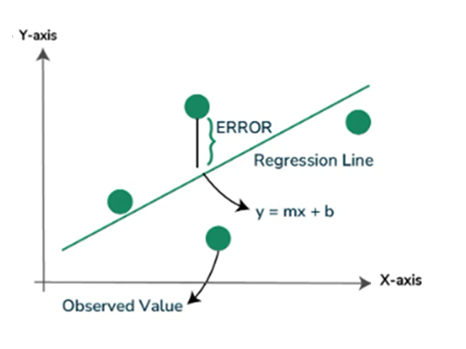
Simple linear regression
Simple linear regression in Machine Learning is a technique used to understand the relationship between one input (predictor) and output (target) variable. This way it can predict the sales for a particular advertisement cost.
In linear regression analysis, we plot a graph where we try to draw a line that best fits the data points. This line is called the regression line. The idea is to make sure the vertical distances (also called errors or residuals) between each data point and the line are as small as possible.
There are infinitely many lines that you could draw through a scatter plot of data points. But regression chooses one special line — the best-fit line - the one that minimizes the total squared error, where the error is the vertical distance between each data point and the line.
This is usually done using a method called Least Squares.

Slide 64


Simple linear regression
The least-squares method is a statistical method used to find the line of best fit of the form of an equation such as y = mx + b to the given data.
Our main objective in this method is to reduce the sum of the squares of errors as much as possible. This is the reason this method is called the least-squares method.
For just one observation,
But this is the error of a single data point; our dataset will have multiple instances, and there will be a separate error term for each instance. Therefore, we can add up all the losses and find the loss of the whole model.

Slide 65

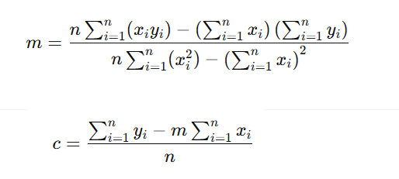

Simple linear regression
The final error term is square of the error over all data points or observations
Now we need to differentiate the Error term with respect to the slope (m) as well as with respect to the intercept (c). And then, by equating the resulting equation to zero, we can find an expression for both slope and intercept.
The Final output comes out as this:
Or u can simply write as:

Slide 66
Simple linear regression
The value “m” is the Slope, and “c” is the Intercept of the regression line. By establishing these two values, we have completed our regression model.
The above is called simple linear regression because the output or dependent variable depends on only one input or independent variable

Slide 67
Simple linear regression
Real-Life Example: Predicting Salary Based on Years of Experience
Suppose you work in HR and want to predict an employee’s salary based on their years of experience.
Years of Experience (X) | Salary (in ₹ lakhs) (Y)
1 | 2.5
2 | 3.0
3 | 4.0
4 | 4.5
5 | 5.0

Slide 68

Simple linear regression
X | Y | XY | X²
1 | 2.5 | 2.5 | 1
2 | 3.0 | 6.0 | 4
3 | 4.0 | 12.0 | 9
4 | 4.5 | 18.0 | 16
5 | 5.0 | 25.0 | 25
ΣX = 15 | ΣY = 19 | ΣXY = 63.5 | ΣX² = 55

Slide 69


Simple linear regression

Slide 70

CORRELATION ANALYSIS

Slide 71


Slide 72


Slide 73


Slide 74


Slide 75


Slide 76



Slide 77


Slide 78










